Slide 1


OAuth

Slide 2
OAuth
“ The OAuth is an authorization framework that enables third party applications to obtain limited access to user accounts on an HTTP service, either on behalf of a resource owner by orchestrating an approval interaction between the resource owner and the HTTP service, or by allowing the third-party application to obtain access on its behalf. ”

Slide 3
Before OAuth
If a third party wanted access to an account, the user would have to give his/her password.
Issues:
The third-party applications stored user’s passwords.
Risk of password exposure
Apps get complete access to user’s account and there is no way to limit the access

Slide 4
oauth1

Slide 5
OAuth1
OAuth 1.0 solves the problem by letting the consumer applications request authorization from the service provider on behalf of user.
Advantages:
User does not divulge their login information
Authorization is granted by the service provider, where both user data and credentials are stored.
The consumer only receives an authorization token that can be used to access data from the service provider.
User has full control of the transaction and can invalidate the authorization token at any time

Slide 6
OAuth1.0 (Roles)
User is a person who want to get access to the protected resource.
Consumer is the application or website that uses OAuth to access the Service Provider for the User.
Service Provider is the web application that allows access via OAuth.
Protected Resource is the data that the user want to access.

Slide 7
OAuth1 Tokens
OAuth1 Authorization uses the Request Token and Access Token to access the resources from the resource server.
Request Tokens
The token containing Consumer Key and Consumer Secret used for asking the service for authorization.
Access Tokens
The token used for accessing the resource.
Consumer key and secret (client credentials): These two strings are used to identify and authenticate the client application (the consumer) making the request.

Slide 8
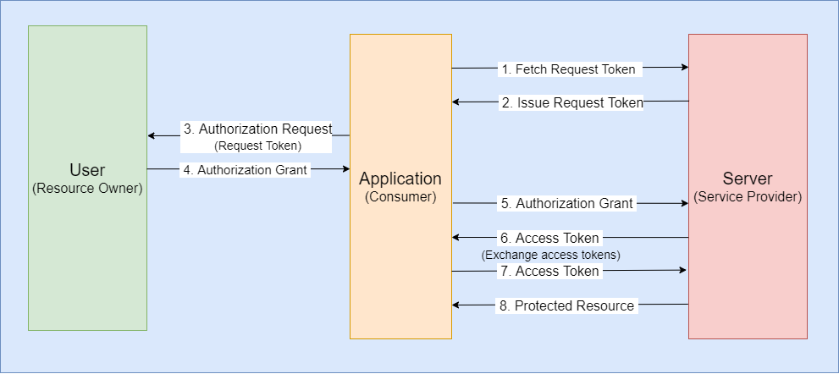
OAuth1 Protocol Flow

Slide 9
OAuth1 Protocol Flow (continued)
The application requests service provider for a Request Token
If the user authorized the request, the application receives an authorization grant
The application requests an access token from the service provider by presenting authentication of its own identity, and the authorization grant
If the application identity is authenticated and the authorization grant is valid, the service provider issues an access token to the application. Authorization is complete.
The application requests the resource from the resource server and presents the access token for authentication
If the access token is valid, the resource server serves the resource to the application
The application requests authorization to access service resources from the user
The service provider issues a Request Token

Slide 10
Problems with OAuth 1.0
Signing Every Request
The client generates signatures on every API request
For each request, the signatures are validated by the server.
OAuth2 removed this complexity by sending tokens over SSL(HTTPS). Thus, no signatures required in OAuth2
Addressing Native Applications
Lacks the support needed for non-browser based application clients

Slide 11
oauth2

Slide 12
OAuth2 Roles
OAuth2 defines four roles:
Resource Owner:
The User of Application
Authorizes the system to access his account
Access is limited to the authorization scope granted by Resource Owner
Client
The third-party application.
Resource Server
The API
Hosts the protected user accounts
Authorization Server
Verifies the user identity
Often same as the API Server

Slide 13
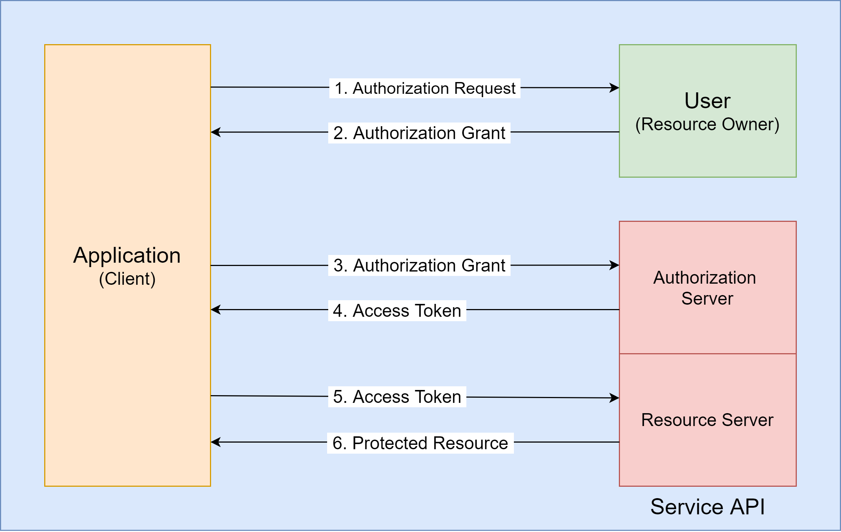
OAuth2 Flow

Slide 14
OAuth2 Flow (continued)
The application requests authorization to access service resources from the user
If the user authorized the request, the application receives an authorization grant
The application requests an access token from the authorization server (API) by presenting authentication of its own identity, and the authorization grant
If the application identity is authenticated and the authorization grant is valid, the authorization server (API) issues an access token to the application. Authorization is complete.
The application requests the resource from the resource server (API) and presents the access token for authentication
If the access token is valid, the resource server (API) serves the resource to the application

Slide 15
Authorization Grant
An authorization grant is a credential representing the resource owner's authorization (to access its protected resources) used by the client to obtain an access token.
There are 4 Grant Types:
Authorization code
Implicit
Resource owner password credentials
Client credentials

Slide 16
Authorization Code
An authorization server is used as an intermediary between the client and resource owner.
Instead of requesting authorization directly from the resource owner, the application requests for authorization code to authorization server.
The authorization server authenticates the resource owner and obtains authorization.
Then, the authorization server directs back to the client with the authorization code
Advantage:
Because the resource owner only authenticates with the authorization server, the resource owner's credentials are never shared with the client.

Slide 17
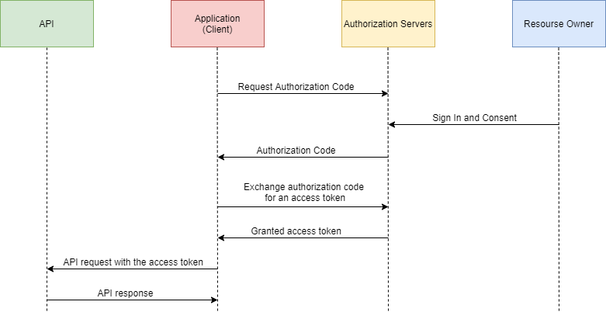
Authorization Code

Slide 18
Implicit
In the implicit flow, the client is issued an access token directly instead of issuing the client an authorization code.
The grant type is implicit as no intermediate credentials (such as an authorization code) are issued.
When issuing an access token, the authorization server does not authenticate the client.
The client’s identity can be verified via the redirection URI used to deliver the access token to the client.

Slide 19
Implicit
Advantages:
Implicit grant is a simplified authorization code flow optimized for clients implemented in a browser using a scripting language such as JavaScript.
It improves the responsiveness and efficiency of clients, since it reduces the number of round trips required to obtain an access token.
Disadvantage:
The access token may be exposed to the resource owner or other applications with access to the resource owner's user-agent

Slide 20
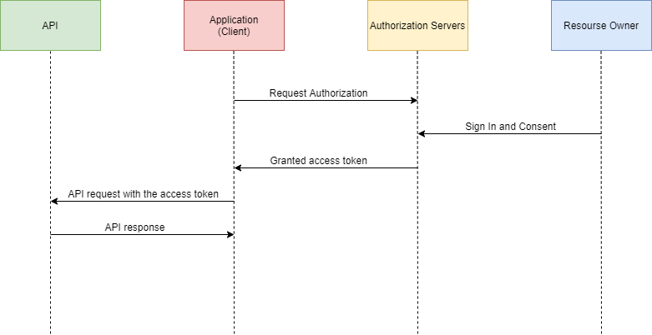
Implicit

Slide 21
Resource Owner Password Credentials
Requires Username and Password of resource owner to obtain an access token.
The credentials should only be used when there is a high degree of trust between the resource owner and the client
The resource owner credentials are used for a single request and are exchanged for an access token.
Next time, both parties can exchange the credentials with a long-lived access token or refresh token. Thus, there is no need to store the resource owner credentials with client.

Slide 22
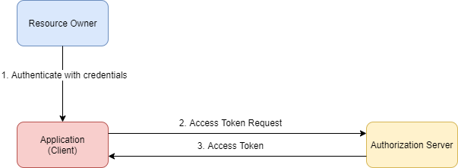
Resource Owner Password Credentials

Slide 23
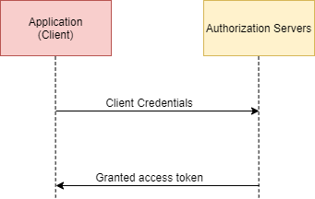
Client Credentials
Client credentials can be used as an authorization grant typically when:
The client is acting on its own behalf (the client is also the resource owner)
The client is requesting access to protected resources based on an authorization previously arranged with the authorization server.

Slide 24
Use Cases and Grants
Web-server apps - Authorization Code
Browser-based apps - Implicit
Username/password access - Resource Owner Password Credentials
Application access - Client Credentials
Mobile apps - Implicit

Slide 25
References
https://oauth.net/core/1.0a/
https://www.synopsys.com/blogs/software-security/oauth-2-0-vs-oauth-1-0/
https://tools.ietf.org/html/rfc6749
https://www.varonis.com/blog/what-is-oauth/

